Slide 1
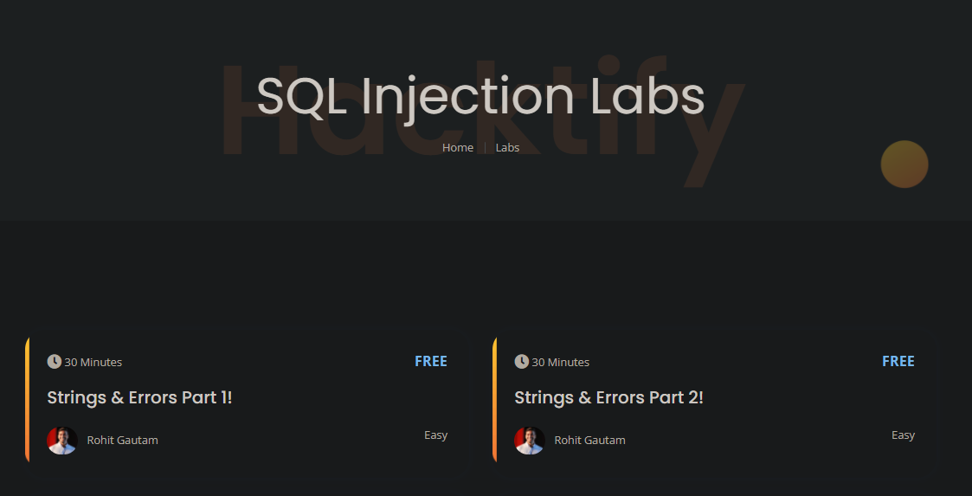
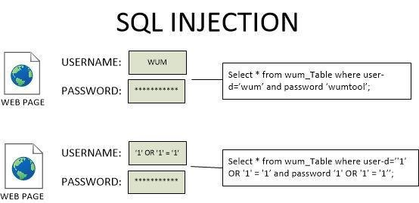

Week 9 as a Penetration Testing Intern
SQL Injection vulnerability
Types of SQL Injection
Severity, impact, prevention of SQL Injection
SQL Injection
Virtually Testing Foundation

